Slide 1
Q3 Student Performance Analysis

Slide 2
Important Note:
All grey boxes (like this one) are included in order to comply with confidentiality agreements with the school.

Slide 3
Caveats/Important Notes:
This is done on progress report data, so these aren’t the final outcomes for grade or passing
E.g., if a class had a big project due shortly before Q3 close, grades may be lower than usual due to temporary missing work
All calculations use gradient grades (e.g., B+=3.3, B-=2.7) rather than step grade (B+ and B- =3)
Chose for descriptive power, even though other is used for GPA
The most predictive model found can only explain 18% of the data’s variation -- typical in education
Education has many outside factors that aren’t included in this data (e.g., home support, work completion, past learning, etc.)
Altogether, the factors in this analysis represent a moderate explanations of the variance in students success rates

Slide 4
Overview of Major Findings
Time with teacher (mostly absences, but also tardies) is largest predictor of grades/pass rates
Explains 8.5% of all variation in student grades
Averages, norms, and predictors varied by class type (core vs. non-core)
Shared largest predictors: support seminar/class absences
When split by core/non-core, this analysis explains 11% of variation in core class grades (single biggest finding)
Avg. core class grades are ~.6 grade point less than non-core avg
Support needs (IEP/504 in particular) had small, statistically significant negative impact on grades
Bonus: Grades by department, course, year

Slide 5
Finding #1
?
Time spent/missed with teacher is largest predictor of student success, even when controlling for other variables
*Note: Includes class absences and tardies (both specific to the class with the associated grade) and support seminars absences (for any class -- specific to the student, not the grade)

Slide 6
Finding #1: ↑ Attendance = ↑ Grades
Subfindings:
Attendance-related factors explain ~8.5% of the total ~13% of variation explained by this model
While ~50% of students miss 5% or less of classes, ~15% of students miss 20%+ of their classes
Students can miss ~15% of classes before it correlates to notably lower chances of passing
Does correlate to lower grades immediately with each absence
Missed support seminars (regardless of associated class) decrease grade/pass rates for all classes
Potentially a measure of follow-through more than attendance?

Slide 7
Note
Q3 had 20 days for each class, so missing 3 classes would be missing 15% of the classes
Takeaway
More than half of student have no attendance issues
Class Absence Norms and Averages
Class Absence Rate | *Count | % of Class per Student | Avg. Classes Missed | Average Grade Point | Pass %
Low (0-9%) | 4255 | 51.0% | 0.52 | 3.32 (B+) | 97.7%
Medium (10-19%) | 2755 | 33.0% | 2.38 | 3.17 (B) | 96.3%
High (20-39%) | 1159 | 13.9% | 4.85 | 2.76 (B-) | 91.8%
Very High (40%+) | 180 | 2.2% | 9.63 | 2.01 (C) | 72.2%
Total | 8350 | -- | 1.93 | 3.17 (B) | 95.9%
Takeaway
Over 15% of students miss more than 20% their course
*Note: This tally is by each student’s class (like class grades; each class per student)

Slide 8
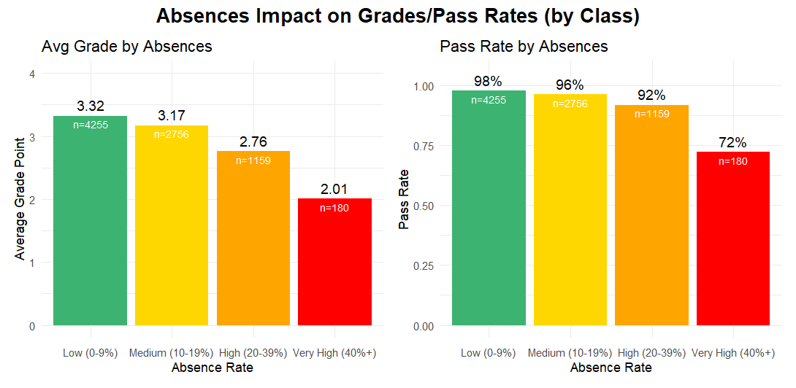
Takeaway
Number of absences affects grade earlier and larger than pass rates
Figure Note
n=__ indicates the number of student class grades included in that bar
Takeaway
Absences are most correlated to lower pass rates for very high absence rates
Takeaway:
Student can miss up to 15% of classes without large changes in their pass likelihood (though does show up in grade)
Overall Takeaway: Higher class absences are correlated with lower grades and lower pass rates, particularly once absence percentage gets above 20%

Slide 9
Key
Explained Percent: Percentage of grade variation explained by this variable alone (i.e., independent effect size)
P Value: Measure of statistical significance. Values with p < .01 are considered significant
Factors Explaining Grade Point
Factor | Explained Percent | P Value | Details
Class Att. | 4.42% | .0000 | Each missed class lowers expected grade point by ~.07
SS Atten. | 3.12% | .0000 | Each missed sup. sem. lowers expected grade by ~.07
TAG | 2.53% | .0000 | +.34 grade point compared to non-TAG
Tardies | 0.96% | .0000 | Each tardy = -.05 for the associated class
IEP | 0.94% | .0000 | -.24 grade point compared to non-IEP
504 | 0.92% | .0000 | -.28 grade point compared to non-504
ELL | 0.08% | .0072 | -.21 grade point compared to non-ELL
Takeaway
Missed support seminars are correlated with decreases in grade regardless of which class’s support seminar the student was signed up for -- more a measure of follow through?
Small but notable effect size
Small-to- negligible effect size (but still statistically significant)
Takeaway
Altogether, attendance-related factors explain about 8.5% of the total 13% of variation explained by this model
*Note: All values are for factors when controlling for other variables

Slide 10
Finding #2
?
Core classes and non-core classes have notable differences in grades and pass rates. They also have different predictors of academic success
*Note: Core classes defined as English, Math, Science, or Social Studies classes that contribute to graduation requirements; doesn’t include requirements in language, health/PE, arts, or electives

Slide 11
Finding #2: Core vs. Not Differences
Subfindings:
Large differences in average grades/passing rates
Attendance-related factors are the main predictors of success for both core/non-core classes
Core: Explains ~11.2% of the ~18% of total variation explained
Non-core: Explains ~8.7% of ~10.3% total variation explained
Core/non-core classes differ by attendance type
Core: Missed support seminars matter most, explaining 6% of variation (beyond that explained by class absence or demographics)
Non-core: Class absences explain 4.3% beyond other variables
Core/non-core classes differ by demographic type
Both: TAG correlated to higher grades, IEP/504 to lower grades
Core: Larger gap in TAG, IEP, and 504 (about a grade step); no ELL
Non-core: Lower differences for TAG, IEP, 504; larger for ELL

Slide 12
Takeaway
Students attend core classes just slightly more often than non-core
Class Absence Norms by Class Type
 | Core Classes |  |  |  | Non-Core Classes
Class Absence Rate | Count (%) | Average Grade Point | Pass % | A-C % | Count (%) | Average Grade Point | Pass % | A-C %
Low (0-9% | 2603 (53%) | 3.32 (B+) | 97.7% | 96.5% | 1652 (48%) | 3.65 (A-) | 99.5% | 97.4%
Medium (10-19%) | 1540 (32%) | 3.17 (B) | 96.3% | 94.3% | 1216 (35%) | 3.53 (B+) | 98.8% | 96.4%
High (20-39%) | 645 (13%) | 2.76 (B-) | 91.8% | 87.9% | 514 (15%) | 3.21 (B) | 96.7% | 89.7%
Very High (40%+) | 94 (2%) | 2.01 (C) | 72.2% | 63.8% | 86 (2%) | 2.43 (C+) | 81.4% | 66.3%
Total | 4882 | 2.92 (B) | 94.1% | 87.5% | 3468 | 3.51 (B+) | 98.4% | 95.1%
Takeaway
Core and non-core classes see similar rates of grades between A and C
*Note: This tally is by each student’s class (like class grades; each class per student)

Slide 13
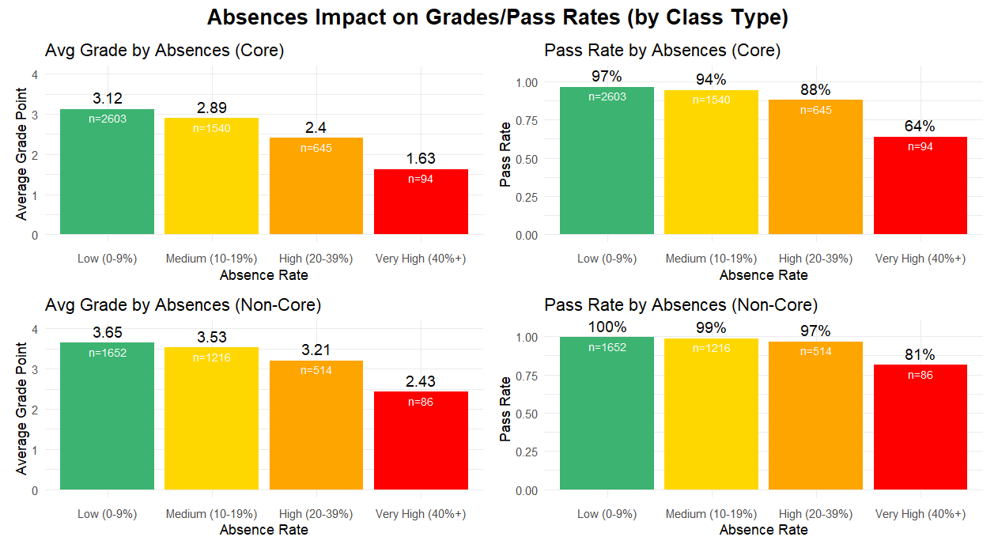
Strongest correlation:
Absences to grades in core classes
Takeaway
Absences rates correlate to lower passing rates and lower grades earlier for core classes than non-core classes
Takeaway
Students don’t suffer large impact in passing rates of non-core classes unless they miss 40%+ of classes
Takeaway
If students attend non-core classes, they nearly always pass
Overall Takeaway: Success in core classes is more strongly correlated to attendance than in non-core classes

Slide 14
Key
Explained Percent: Percentage of grade variation explained by this variable alone (i.e., independent effect size) for core/non-core class
P Value: Measure of statistical significance. Values with p < .01 are considered significant
Factors Explaining Grade Point (by Course Type)
 | Core Classes |  |  | Non-Core Classes
Factor | Explained Percent | P Value | Details | Explained Percent | P Value | Details
SS Att. | 6.07% | .0000 | -.09 per missed SS | 3.39% | .0000 | -.05 per missed SS
Class Att. | 3.85% | .0000 | -.07 per missed class | 4.28% | .0000 | -.07 per missed class
TAG | 3.88% | .0000 | +.45 grade point | 1.23% | .0000 | +.19 grade point
IEP | 1.51% | .0000 | -.39 grade point | 0.75% | .0000 | -.19 grade point
504 | 1.45% | .0000 | -.37 grade point | 0.44% | .0005 | -.15 grade point
Tardies | 1.24% | .0000 | -.05 per tardy | -- | .0282 | No statistical significance
ELL | -- | .2400 | No statistical significance | 0.18% | .0085 | -.28 grade point
TOTAL | 18.00% | .0000 | Excludes ELL | 10.27% | .0000 | Excludes Tardies
Takeaway
Support seminar absences (without regard to which class) have notably largest effect on core classes (~11% explained)
Takeaway
Demographic factors (TAG, IEP, and 504) are larger predictors for core classes than non-core (except ELL)
Overall Takeaway: Both core and non-core classes vary strongest with attendance. Demographic factors also have smaller but significant correlation.

Slide 15
Finding #3
?
Support needs (IEP and 504) have negative correlation to grades. TAG has positive correlation with grades. This is particularly for core classes.
*Note: Support needs could include IEPs, 504s, ELL status, transfer status. While different, I also included non-support demographic features like gender and TAG status in this section.

Slide 16
Finding #3: ↓ IEP/504, ↑ TAG, ? ELL
“Grade Step”
Referring to difference between A and A-, A- and B+, etc. -- about .3-.4 grade point difference
Subfindings:
Core: students with 504s/IEPs average ~1 grade step less; TAG is ~1 grade step more
Effect size is small (doesn’t explain much variation), but still significant
Same trends with non-core classes, but less impact (half step)
Non-core: ELLs average ~1 grade step less (statistic significance even with small sample size -- notable)
Seems ELL students are much more impacted by absences, particularly for non-core classes
This could be skewed by small sample size, but true for this group
No statistical significance in differences by gender or transfer status after controlling for other variables
Notable nonbinary gaps, but too low of sample size to be sure

Slide 17
Note
Intensity of highlighting indicates how extremely this value deviates from the “Alll Factors” average
Takeaway
IEP/504 grade difference is partially explained by class and support seminar absences, but not fully
Summary of Demographic Factors
Demographic Factor | Count (%) | Avg. Absences | Avg. SS Absences | Avg. Grade | Pass Rate | A-C Rate
IEP | 856 (10%) | 11.66% | 18.39% | 2.79 | 91% | 85%
504 | 966 (12%) | 12.18% | 16.98% | 2.83 | 93% | 85%
ELL | 172 (2%) | 5.52% | 12.31% | 2.97 | 94% | 88%
TAG | 2300 (28%) | 8.91% | 8.91% | 3.49 | 99% | 96%
Transfer | 1209 (14%) | 9.51% | 14.22% | 3.06 | 96% | 89%
Gen: M | 4363 (52%) | 8.79% | 12.94% | 3.07 | 95% | 90%
Gen: F | 3909 (47%) | 10.51% | 13.28% | 3.28 | 97% | 92%
Gen: NB | 78 (1%) | 15.26% | 16.52% | 2.99 | 92% | 87%
All Factors | 8350 | 9.66% | 12.53% | 3.17 | 96% | 91%
Note
ELL varied in stat. sign. by type of class; see next slide
Note
After controlling for other factors, these didn’t show statistically significant difference. (For NB, could be due to sample size)

Slide 18
Key
Explained Percent: Percentage of grade variation explained by this variable alone (i.e., independent effect size) for core/non-core class
P Value: Measure of statistical significance. P < .01 is significant
Note
All values are while controlling for other variables
Factors Explaining Grade Point (by Course Type)
 | Core Classes |  |  | Non-Core Classes
Factor | Explained Percent | P Value | Details | Explained Percent | P Value | Details
SS Att. | 6.07% | .0000 | -.09 per missed SS | 3.39% | .0000 | -.05 per missed SS
Class Att. | 3.85% | .0000 | -.07 per missed class | 4.28% | .0000 | -.07 per missed class
TAG | 3.88% | .0000 | +.45 grade point | 1.23% | .0000 | +.19 grade point
IEP | 1.51% | .0000 | -.39 grade point | 0.75% | .0000 | -.19 grade point
504 | 1.45% | .0000 | -.37 grade point | 0.44% | .0005 | -.15 grade point
Tardies | 1.24% | .0000 | -.05 per tardy | -- | .0282 | No statistical significance
ELL | -- | .2400 | No statistical significance | 0.18% | .0085 | -.28 grade point
TOTAL | 18.00% | .0000 | Excludes ELL | 10.27% | .0000 | Excludes Tardies
Takeaway
Students with IEPs/504s average ~one gradient grade step lower than their peers (e.g., B instead of B+) in core classes; TAG students average ~one step higher (e.g., A- instead of B+)
Takeaway
Dem. factors explain only 2.6% of variance in non-core
Takeaway
Demographic factors (TAG, IEP, and 504) explain 6.8% of variance in core classes
Takeaway
ELL students average just under one grade step lower than peers in non- core classes

Slide 19
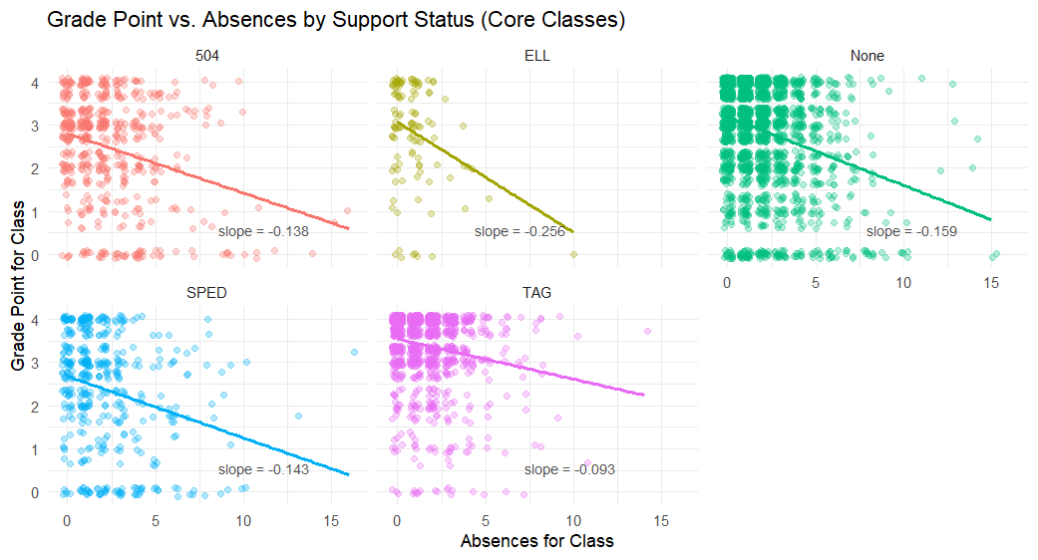
Note
Small ELL sample size could skew conclusions
Takeaway
ELL students are about 60% more impacted by absences than other groups
Takeaway
TAG students are impacted by absences about 60% as much as other groups
Takeaway
Students with IEPs/504s are slightly less impacted by absences than non-support group (potentially due to support for notes, catching up, etc.)

Slide 20
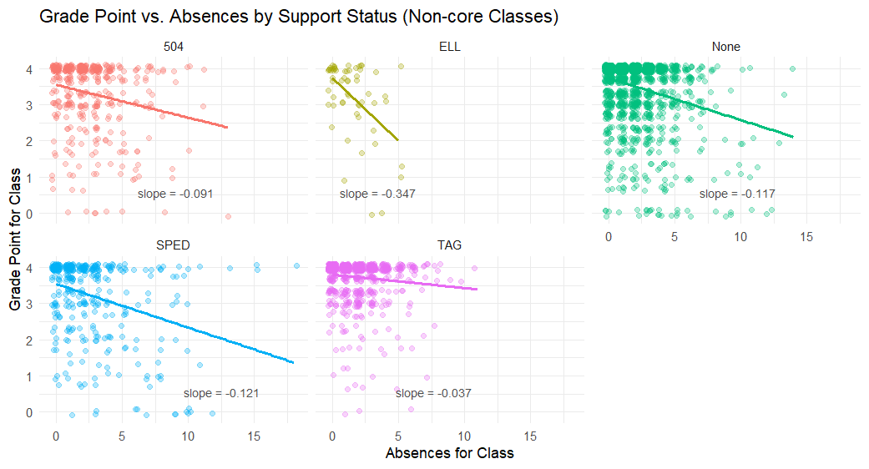
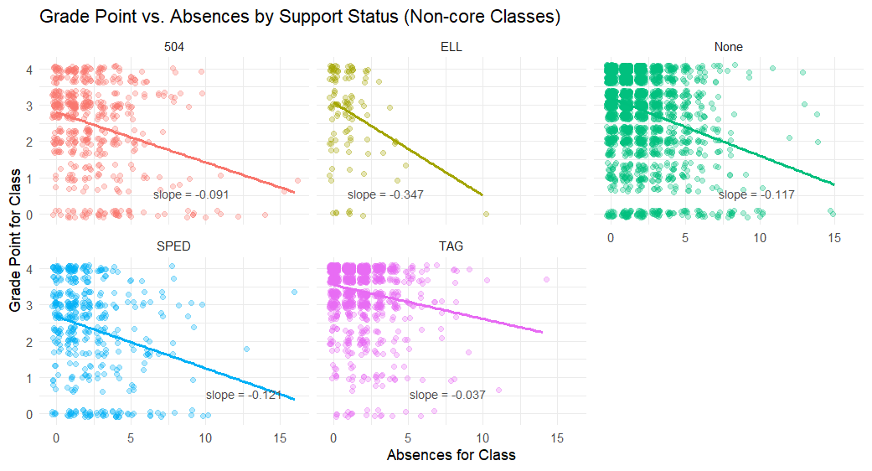
Note
Small ELL sample size could skew conclusions
Takeaway
ELL students are 3x as impacted by absences as other groups
Takeaway
TAG students are impacted by absences ~1/3 as much as other groups
Takeaway
Students with 504s are slightly less impacted and students with IEPs are slightly more impacted than non-support group

Slide 21
Other Helpful Tables
?
Additional tables that were created while trying to understand the data

Slide 22
Summary of Grades by Grade Levels
Grade Level | Count (%) | Avg. Absences | Avg. SS Absences | Avg. Grade | Pass Rate | A-C Rate
9th Grade | 2252 (27%) | 6.97% | 9.52% | 3.22 | 96% | 92%
10th Grade | 2357 (28%) | 9.22% | 12.33% | 3.15 | 96% | 91%
11th Grade | 2156 (26%) | 10.18% | 14.37% | 3.16 | 96% | 90%
12th Grade | 1585 (19%) | 13.41% | 17.76% | 3.13 | 95% | 90%
All Students | 8350 | 9.66% | 12.53% | 3.17 | 96% | 91%
*Note: This tally is by each student’s class (like class grades; each class per student)

Slide 23
Summary of Grades by Department
Department | Count (%) | Avg. Absent % | Avg. Grade | Pass Rate | A-C Rate
Mathematics | 1202 (14%) | 9.7% | 2.56 | 90% | 79%
English | 1480 (18%) | 9.5% | 3.00 | 95% | 90%
Science | 1446 (17%) | 9.2% | 3.08 | 96% | 91%
Social Studies | 1250 (15% | 9.4% | 3.11 | 95% | 90%
World Language | 699 (8%) | 8.8% | 3.30 | 99% | 93%
CTE | 592 (7%) | 8.7% | 3.42 | 98% | 95%
Support Prog. | 107 (1%) | 11.8% | 3.57 | 100% | 100%
PE/Health | 640 (8%) | 10.2% | 3.67 | 99% | 96%
Fine Arts | 784 (9%) | 11.3% | 3.72 | 99% | 97%
Other | 150 (2%) | 13.9% | 3.92 | 100% | 100%
All Classes | 8350 | 9.7% | 3.17 | 96% | 91%

Slide 24
Summary of Grades by Department (Core Classes)
Demographic Factor | Count (%) | Avg. Absences | Avg. Grade | Pass Rate | A-C Rate
Mathematics | 1189 (24%) | 9.7% | 2.56 | 90% | 79%
English | 1390 (28%) | 9.3% | 2.97 | 95% | 90%
Science | 1295 (27%) | 8.9% | 3.07 | 95% | 90%
Social Studies | 953 (20% | 8.7% | 3.09 | 96% | 91%
Support Prog. | 107 (1%) | 13.3% | 3.51 | 100% | 100%
All Core Classes | 4882 | 9.2% | 2.92 | 94% | 87%
*Note: This tally is by each student’s class (like class grades; each class per student)

Slide 25
Classes with Lowest Grades (Limit 15)
Course Title | Student Count | Avg. Classes Missed | Average Grade Point | Pass % | A-C %
Integrated Alg/Geom | 43 | 10.9% | 2.17 | 93% | 70%
AP Calculus AB | 82 | 8.4% | 2.18 | 95% | 63%
Financial Algebra | 77 | 18% | 2.28 | 83% | 68%
Adv Algebra | 114 | 10.3% | 2.31 | 89% | 78%
Algebra | 177 | 7.4% | 2.32 | 80% | 72%
Geom/Reasoning | 201 | 7.4% | 2.35 | 87% | 76%
AP European History | 30 | 9.0% | 2.35 | 87% | 73%
Lit through Film | 21 | 10.0% | 2.39 | 81% | 76%
AP Statistics | 122 | 11.4% | 2.47 | 93% | 77%
AP US Government | 29 | 12.8% | 2.62 | 86% | 76%
English 12 | 221 | 12.4% | 2.65 | 92% | 85%
Concert Band | 223 | 5.0% | 2.7 | 100% | 70%
Adv Algebra/Trig | 133 | 8.1% | 2.72 | 91% | 82%
Oceanography | 43 | 11.7% | 2.75 | 93% | 86%
Intro to Physics | 80 | 11.1% | 2.81 | 91% | 84%
All Classes | 8350 | 9.7% | 3.17 | 96% | 91%

